Slide 1
CASE STUDY – PERL APPLICATIONS SECURITY HARDENING
Carnegie Mellon Software Engineering Institute
https://wiki.sei.cmu.edu/confluence/display/perl/SEI+CERT+Perl+Coding+Standard

Slide 2
CASE STUDY – PERL APPLICATIONS SECURITY HARDENING
1. Identify critical assets (& asset owner)
2. Research on applicable security controls
3. Checklist of applicable controls
5. Implement controls on test setup
4. Document controls into SOP
6. Validation of control implementation
7. Change management process for PROD
8. Implement on PROD & monitor

Slide 3
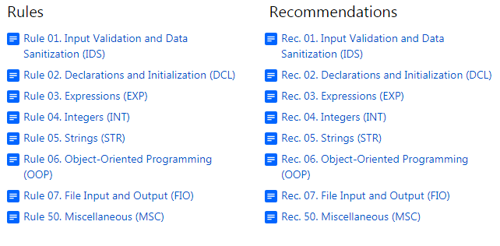
CASE STUDY – PERL APPLICATIONS SECURITY HARDENING

Slide 4
CASE STUDY – PERL APPLICATIONS SECURITY HARDENING
Rule 1
IDS30-PL. Exclude user input from format strings

Slide 5
CASE STUDY – PERL APPLICATIONS SECURITY HARDENING
Never call any formatted I/O function with a format string containing user input.
An attacker who can fully or partially control the contents of a format string can crash the Perl interpreter or cause a denial of service. She can also modify values, perhaps by using

Slide 6
CASE STUDY – PERL APPLICATIONS SECURITY HARDENING
…the %n|| conversion specifier, and use these values to divert control flow. Their capabilities are not as strong as in C [Seacord 2005]; nonetheless the danger is sufficiently great that the formatted output functions {{sprintf() and printf() should never be passed unsanitized format strings.

Slide 7
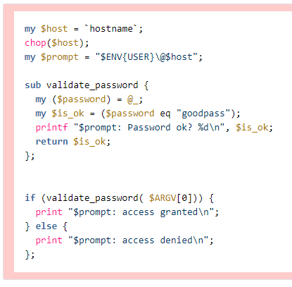
CASE STUDY – PERL APPLICATIONS SECURITY HARDENING

Slide 8
CASE STUDY – PERL APPLICATIONS SECURITY HARDENING
This noncompliant code example tries to authenticate a user by having the user supply a password and granting access only if the password is correct.

Slide 9
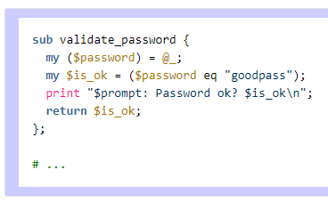
CASE STUDY – PERL APPLICATIONS SECURITY HARDENING

Slide 10
CASE STUDY – PERL APPLICATIONS SECURITY HARDENING
This compliant code example avoids the use of printf(), since print() provides sufficient functionality.
END

